Slide 1
Chapter 12 lesson 3
THE MALE REPRODUCTIVE SYSTEM
Pg. 374

Slide 2
Parts of the MRS
Main job → produce sperm
Sperm → male reproductive cells
Testes → pair of glands that produce sperm and testosterone
  In the scrotum → controls temperature
Semen → mixture of sperm and fluids
  Fluids protect sperm and carry them through the MRS
  Released from urethra through the penis (ejaculation)
Prostate → produces fluids that protect the sperm that helps it move
Penis → spongy tissue that has many blood vessels
Epididymis → collection of tubes where the mature sperm is stored

Slide 3
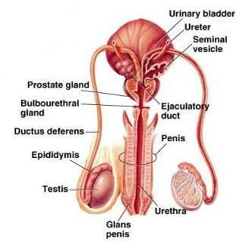

Slide 4
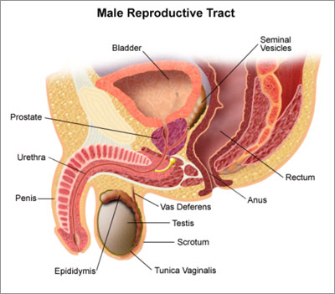

Slide 5
Chapter 12 Lesson 4
THE FEMALE REPRODUCTIVE SYSTEM
Pg. 378

Slide 6
Parts of the female reproductive system
3 main functions:
  Produce egg cells
  Create new life
  Give birth
Ovaries – female reproductive glands that release mature eggs and produce estrogen and progesterone (hormones)
Uterus – pear-shaped organ within the pelvis in which the developing baby is nourished and protected

Slide 7
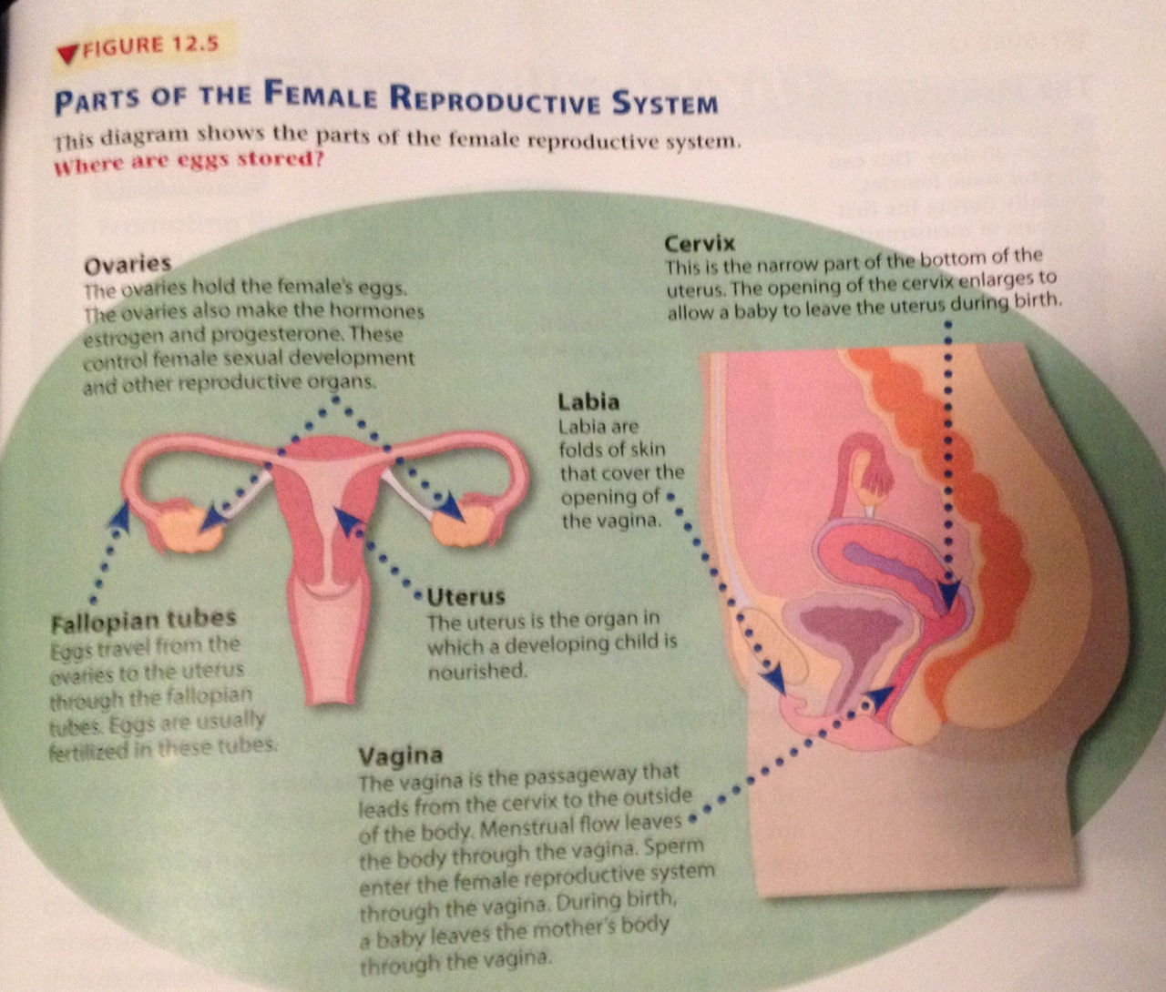

Slide 8
The menstrual cycle
Series of events that prepares the female reproductive system for reproduction
Length varies from female to female
  Typically 28 days
(1) Hormones cause the lining of the uterus to build up with a cushion of blood, tissue, and fluid
(2) Estrogen levels peak → ovulation
  Ovaries release mature eggs
(3) Egg isn’t fertilized → lining of the uterus breaks down = menstruation
  Flow from the body of blood, tissues, and fluids
  2-7 days

Slide 9
fertilization
Joining of male sperm cell and a female egg cell to form a fertilized egg

Slide 10
Female health problems
Yeast infection – infection due to abundance of bacteria (treatable)
Vaginitis – infection (treatable)
Toxic shock syndrome (TSS) – bacteria infection due to misusage of tampons (>24 hours)
Cancer – breasts, ovaries, uterus, cervix; uncontrolled cell growth (rare among teens)
Sterility – inability to produce children
Infertility – reduced ability to produce children

Slide 11
Caring for the FRS
Breast self-exam every month
Shower/bathe regularly
Keep track of your menstrual cycle
  Seek attention if you have missed for a prolonged period of time or if there is severe pain/symptoms
Visit a gynecologist for regular check ups
  Doctor who specializes in the FRS

