Slide 1
Chapter 3 Lesson 5
Weight Training and sports

Slide 2
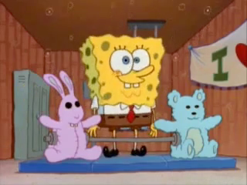

Slide 3
Weight Training Basics
Weight training is a form of resistance training
What can weight training do for you?
  Make you stronger
  Tones muscles
  Strengthens bone
  Weight management
Learn proper form!
Every body is different → have a goal before you start!

Slide 4


Sports For Fun And Wellness
Great way to stay fit
Competitive vs. Recreational
  Examples?
Practice makes perfect

Slide 6
Eating Right
Eat right. Period.
http://www.choosemyplate.gov/
Hydrate, hydrate, hydrate!
  What is dehydration?

Slide 7
When You Eat
DO
DON’T
Eat a light snack 1-2 hours before
Drink a lot of fluids before, during, and after activity
Refuel with food after activity
Eat a heavy meal right before physical activity
Wait until you’re thirsty to drink

Slide 8
Dangerous Substances
Anabolic steroids
  Cause muscle tissue to develop at an extremely high rate
  Affect growth and development
    Weak bones and tendons
    High BP and HR
    Females = FACIAL HAIR and DEEPER VOICES
    “Roid Rage”
Creatine
  Performance enhancer
    Can affect heart kidneys, and liver
Caffeine
  Increase in BP and HR
  Can affect heart rhythm
  NO ENERGY DRINKS!

Slide 9
Training
Conditioning
  Training to get into shape for physical activity
Depends on sport/activity
Overworking
  Conditioning too hard or too often without enough rest between sessions

