Slide 1
CHAPTER 15 LESSON 3
Staying Safe Outdoors
Page 480

Slide 2
SAFETY ON FOOT
Pedestrian → a person who travels on foot
Pay attention to what is happening around you
Walk on sidewalks or on the side of the road facing oncoming traffic
Cross in crosswalks
Look both ways
Make sure the driver can see you when crossing the street
At night, wear light/reflective clothing
Be aware of your surroundings

Slide 3
SAFETY ON WHEELS
Wear a HELMET!!
Wear other appropriate gear (knee pads, etc.)
Clothes fit appropriately
Stay alert when you ride
Ride side-by-side if in a group
Learn hand signals
Avoid riding in bad weather

Slide 4
SAFETY IN VEHICLES
Wear your seatbelt!
Don’t fool around on the bus

Slide 5
NEIGHBORHOOD SAFETY
Don’t travel alone at night or go an area that is unsafe
Walk in well-lit places
Have an ID and cell phone
Be aware → leave if you feel uncomfortable
Get help → run to the nearest public or safe place
  Call 911

Slide 6
SAFETY AT PLAY
Bring friends
Stay aware of your environment (weather)
Know your limits
Use good judgment
Warm up and cool down

Slide 7
HOT AND COLD WEATHER SAFETY
If you feel dizzy, out of breath, nauseous, or have a headache, take a break!
Rest in the shade
Heat exhaustion/Heat stroke
HYDRATE!
Dress in layers, even if you are exercising
Hat, gloves, warm footwear
Hypothermia
HYDRATE!

Slide 8
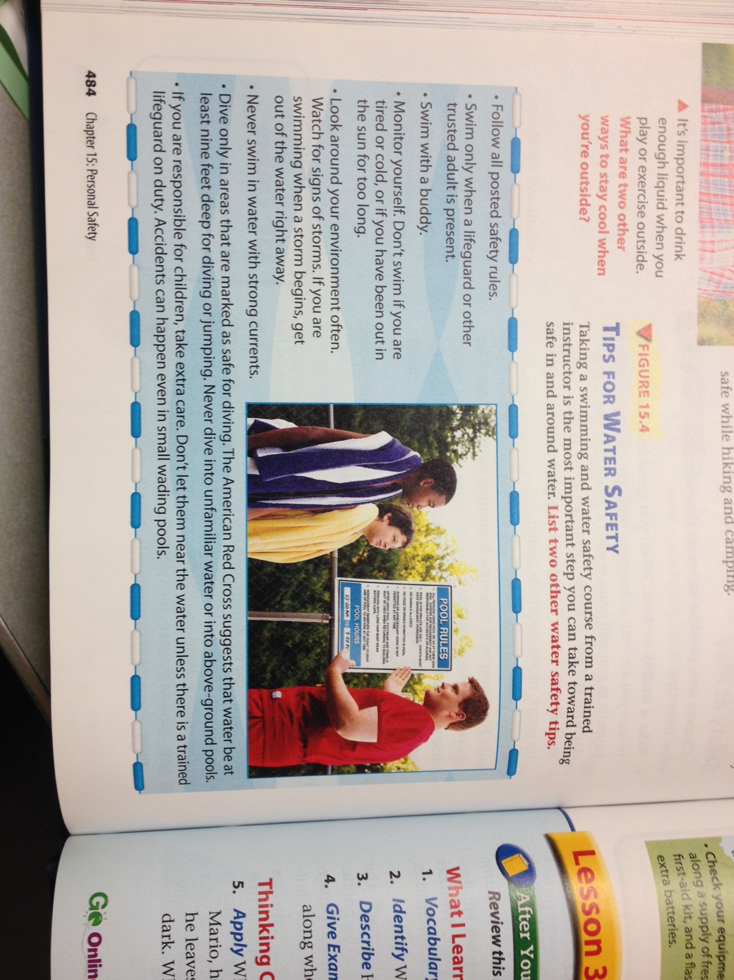
WATER SAFETY

Slide 9
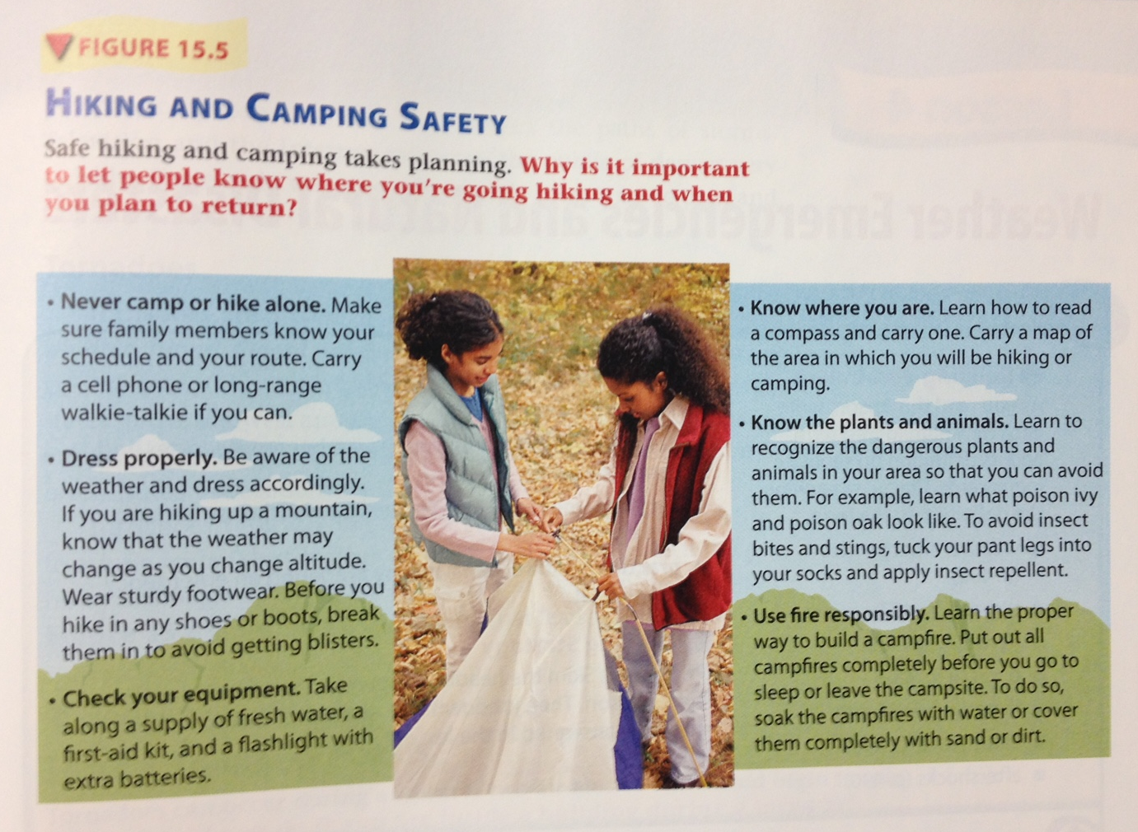
HIKING/CAMPING SAFETY

