Slide 1
CHAPTER 1 LESSON 3
WHAT AFFECTS YOUR HEALTH?
Page 18

Slide 2
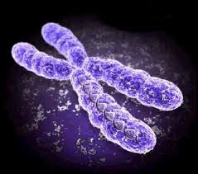
YOUR HEREDITY
The passing of traits from parents to their biological children
You cannot control these factors
Genes
  Units of heredity made from DNA
  ½ from mother, ½ from father
  Control how every cell in your body works
    Being aware of gene map can help to make better decisions about your health

Slide 3
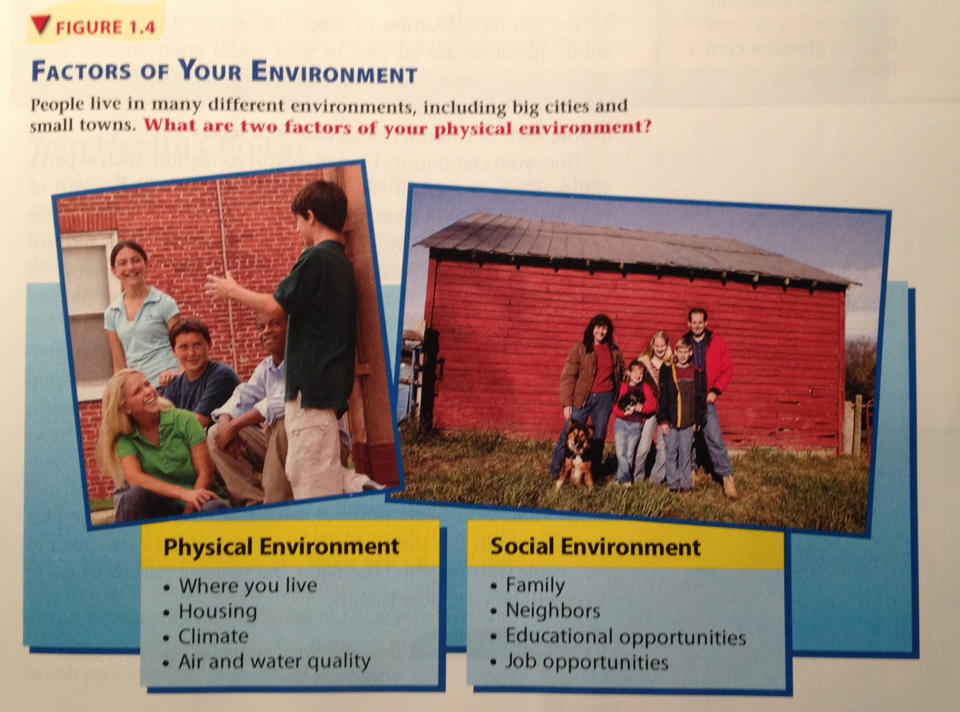
YOUR ENVIRONMENT
All living and nonliving things around you

Slide 4
YOUR ENVIRONMENT (CONT’D.)
You may not be able to change your environments
Recognize the relationship between these factors and your personal health
  Develop strategies for improving and maintaining your health

Slide 5
YOUR HEALTH CHOICES
Depend on many factors:
  Likes
  Dislikes
  Feelings
  Ways of thinking
  Your physical and social environment
    Examples?

Slide 6
INFLUENCE OF FAMILY AND FRIENDS
Family help shape your cultural background
  Beliefs, customs, and traditions of a specific group of people
    My Big Fat Greek Wedding
  Influence the holidays you celebrate, foods you eat, and the activities you participate in
    Tell me about your cultural background(s)
Friends can influence you positively or negatively
  How?

Slide 7
INFLUENCE OF THE MEDIA
TV, radio, movies, magazines, newspapers, books, billboards, the internet, etc.
You need to evaluate everything you see, hear, or read
  Is the source reliable?

Slide 8


Slide 9


