Slide 1
Chapter 7 Lesson 3
PREVENTING VIOLENCE

Slide 2


Slide 3
Violence In Society
News, media, TV, etc.
Assault (most common)
  Attack on another person with intent to harm
Robbery
Rape
  Forced sexual contact
Homicide/Murder
  Violent crime that results in the death of another person

Slide 4
Factors That Contribute To Violence
Not learning to handle feelings of anger in healthful ways
Prejudice (hate crimes), availability of weapons, peer pressure, alcohol/drugs
Risk factors
  Engaging in risky behaviors
  Having parents who are violent
  Committing crimes when younger
  Seeing violence as an acceptable way to behave
  **Many teens are not violent**

Slide 5
Gangs
Group of young people who come together to take part in illegal activities
B.L.D.

Slide 6
Bullying
Type of violence in which one person uses threats, taunts, or violence to intimidate another again and again
Physical, Verbal, Psychological, Cyber
  Examples?
  PHEOBE PRINCE VIDEO
    http://www.youtube.com/watch?v=bT93vI_NlmI

Slide 7
Sneeches/If You Really New Me??

Slide 8
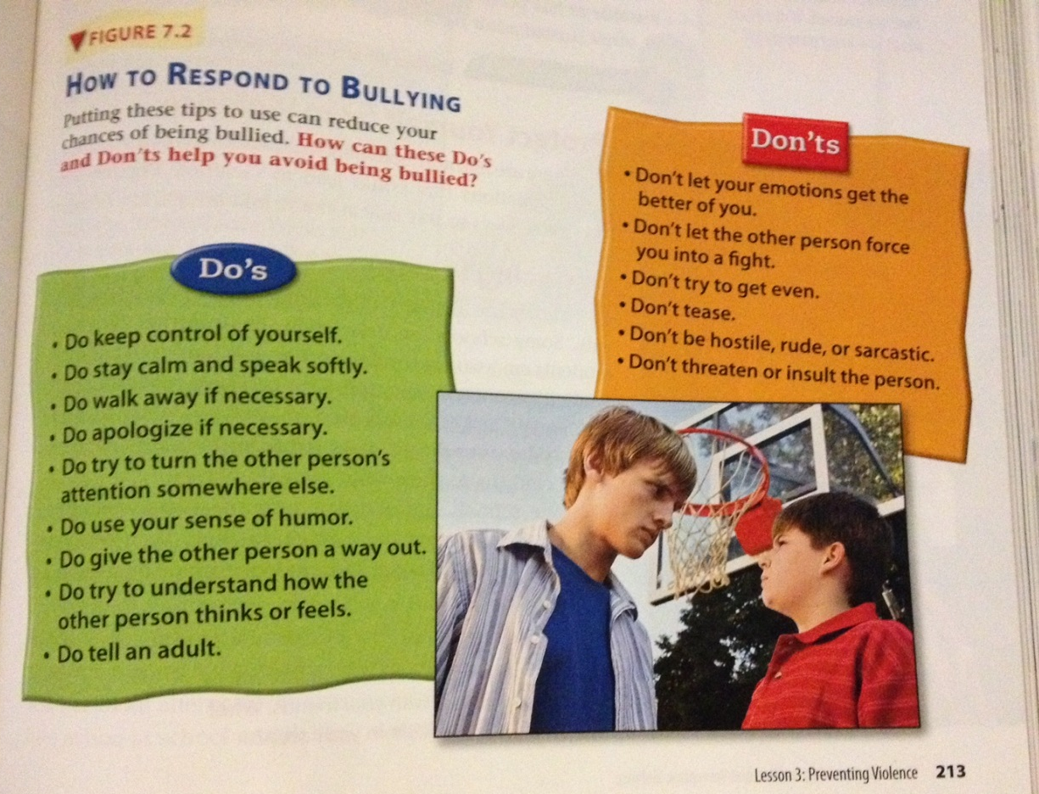

Slide 9
Dating Violence
When a person uses violence in a dating relationship to control his or her partner
  Physical, emotional, psychological
Avoid dating relationships that are not built on respect
Warning signs
  Feeling scared/threatened
  Discovering your date has a history of violence or alcohol/drug abuse
  Feeling put down in front of others
  Feeling controlled
R.A.D.

Slide 10

Reducing Violence At School
In what ways do you think JBMS tries to reduce violence at school?

Slide 11
Reducing Violence In Communities
After-school programs
Lighting in parks/playgrounds
Neighborhood watch programs
Police

