Slide 1
Chapter 3 jeopardy
May the odds be ever in your favor

Slide 2

Jeopardy board
BECOMING PHYSICALLY FIT | SKELETAL AND MUSCULAR SYSTEMS | CIRCULATORY SYSTEM | WEIGHT TRAINING AND SPORTS | PREVENTING PHYSICAL ACTIVITY INJURIES
200 | 200 | 200 | 200 | 200
400 | 400 | 400 | 400 | 400
600 | 600 | 600 | 600 | 600
800 | 800 | 800 | 800 | 800
1000 | 1000 | 1000 | 1000 | 1000

Slide 3

Becoming physically fit
_________________ is any movement that makes your body use extra energy.
200

Slide 4
Becoming physically fit
Name 1 physical benefit and 1 mental/emotional benefit of physical activity.
400

Slide 5
Becoming physically fit
What is the difference between muscular endurance and muscular strength?
600

Slide 6
Becoming physically fit
Name all 5 elements of fitness.
800

Slide 7
Becoming physically fit
What is an example of a fitness test to test for flexibility?
1000

Slide 8
Skeletal and muscular systems
Name the 3 types of connective tissue that help our bones and muscles work together as we move.
200

Slide 9
Skeletal and muscular systems
Your body’s __________ and _________ __________ contain smooth muscle, which is a(n) _____________ type of muscle.
400

Slide 10
Skeletal and muscular systems
Name 3 functions/jobs of the skeletal system.
600

Slide 11
Skeletal and muscular systems
Foods high in _______ can help build muscle. Foods high in ________ help your bones grow and become stronger.
800

Slide 12
Skeletal and muscular systems
Name the 4 types of joints discussed in class with an example of each.
1000

Slide 13
Circulatory system
What are the 3 components of the circulatory system?
200

Slide 14
Circulatory system
_____________ carry oxygen-depleted blood to the _____________.
400

Slide 15
Circulatory system
What are the two blood pressure readings and what do they represent?
600

Slide 16
Circulatory system
_________ circulation → blood travels from the heart to the lungs and back to the heart. _________ circulation → blood travels to all body tissues except to the lungs.
800

Slide 17
Circulatory system
What are the 4 components of blood and what are their specific functions?
1000

Slide 18
Weight training and sports
Give 1 reason why is participating in sport is a positive healthy behavior.
200

Slide 19
Weight training and sports
Drink plenty of water ________, __________, and ________ activity.
400

Slide 20
Weight training and sports
________ _________ are shields that protect your teeth.
600

Slide 21
Weight training and sports
__________ steroids, creatine, and _________ can all affect your health negatively.
800

Slide 22
Weight training and sports
What are 2 signs of overworking?
1000

Slide 23
Preventing physical activity injuries
________ ______ and _______ ________ are important routines to practice before and after you work out.
200

Slide 24
Preventing physical activity injuries
Name 2 tips for injury prevention
400

Slide 25
Preventing physical activity injuries
A _______ is injury to a ligament. A ________ is injury to a muscle.
600

Slide 26
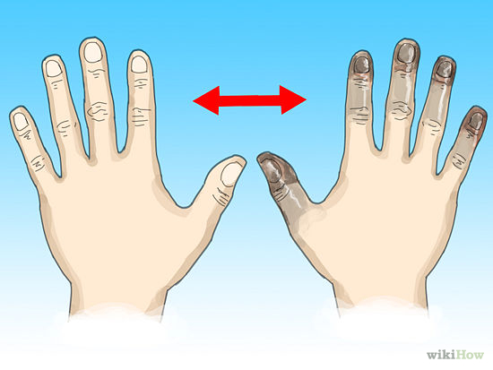
Preventing physical activity injuries
Identify the health problem:
800

Slide 27
Preventing physical activity injuries
During ______ _______, a person can become dizzy and have cool and clammy skin. During _______ _______, a person’s body temperature suddenly increases and can be deadly.
1000

Slide 28

final jeopardy
List and describe each of the 5 steps of the P.R.I.C.E. procedure.

