Slide 1
Chapter 1 Lesson 1
Your Total Health
Page 4)

Slide 2
3 PARTS OF GOOD HEALTH
Health → combination of physical, mental/emotional, and social well-being
Form a triangle → each side supports the other 2 sides (rely on each other)

Slide 3
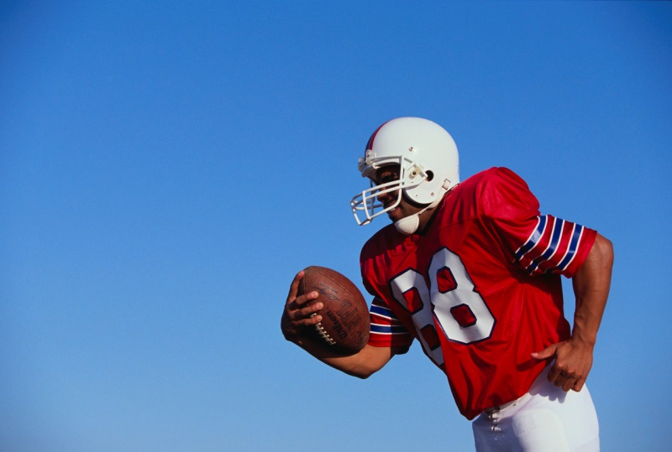


Physical
Mental/Emotional
Social

Slide 4
PHYSICAL HEALTH
The condition of your body
Eating well, physical activity, plenty of sleep
Regular checkups
Healthy hygiene
Protective gear, safety rules

Slide 5
MENTAL/EMOTIONAL HEALTH
Mental → ability to solve problems and handle the daily events of your life
Emotional → involves feelings
Patience with self and others
Taking action to reach your goals
Focus of energy
Making healthy choices and taking responsibility

Slide 6
SOCIAL HEALTH
How you relate to people at home, school and everywhere else!
Building and maintaining relationships with friends and family
Think of our character ed words!

Slide 7
YOUR OVERALL WELLNESS
Wellness → state of balanced health over a longer period of time
Your health constantly changes
  Make healthy and positive decisions for the long haul
  This helps to prevent injury, illness, disease, and other health problems

Slide 8
THE MIND-BODY CONNECTION
How your emotions affects your physical and overall health and how your overall health affects your emotions
Think about an event in your own life that made you feel sad, angry, happy, etc.
  How did you deal with this emotion?

Slide 9
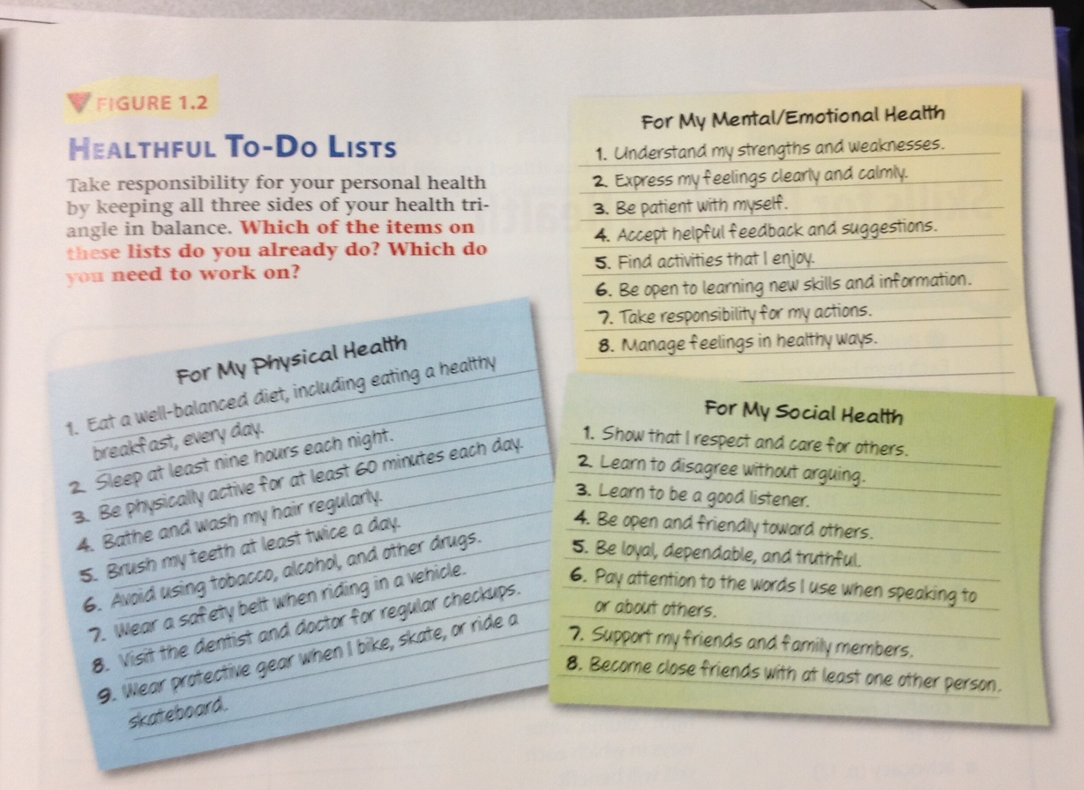
IT’S ALL ABOUT BALANCE

