Slide 1
Chapter 13 Lesson 5/6
SEXUALLY TRANSMITTED DISEASES & HIV/AIDS

Slide 2
What are stds?
Infections that are spread from person to person through sexual contact
AKA STIs
All STDs are passed on to partners who engage in sexual activity
Affect both men and women
Good news: Completely preventable
  Bad news: most STDs found in people ages 15-24

Slide 3
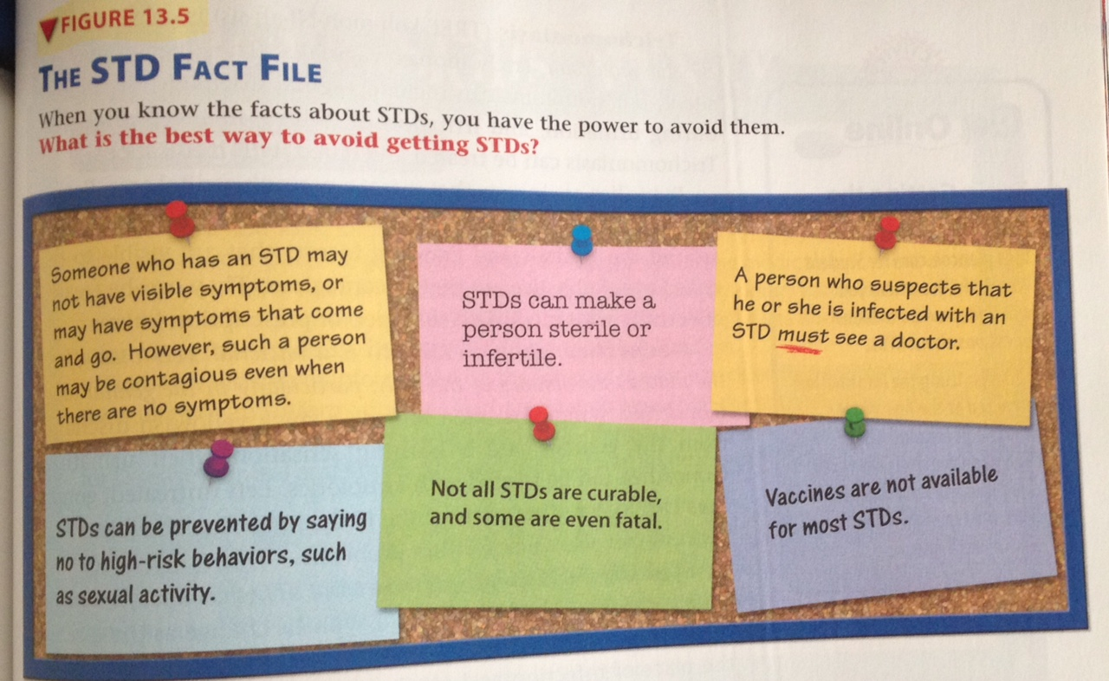

Slide 4
Common stds
Chlamydia
  Bacterial STD that may affect the reproductive organs, urethra, and anus
  “Silent” disease → many cases there are no symptoms
  Symptoms can include discharge and pain while urinating
  Can be treated with antibiotics
Genital warts
  Growths/bumps in the genital area by a type of HPV
  Often a silent disease, causing no obvious symptoms until many years after the INITIAL infection
  Warts can be treated, but not HPV
    HPV is linked to cervical cancer → get your vaccines!!

Slide 5
Common stds (cont’d)
Genital herpes
  Viral STD that produces painful blisters on the genital area
  Periodic outbreaks of blisters/sores
    Even when the symptoms go away, the virus remains in the body
  No cure, but medication to reduce frequency of outbreaks
Trichomoniasis
  Vaginal discharge, discomfort during urination, irritation/itching
  Can be treated with medication
Pubic lice aka “Crabs”

Slide 6
Common stds (cont’d)
Gonorrhea
  Bacterial STD that affects the mucous membranes of the body (genitals)
  Thick discharge from genitals and burning sensation when urinating
  Can be treated with antibiotics (if treated early)
    Can infect other parts of the body and cause fertility problems
Syphilis
  Bacterial STD that affects many parts of the body
  Symptoms change as the disease progresses
    1 → sores and swollen lymph glands (treatable)
    2 → severe rash (treatable)
    Late → bacteria moves throughout body (can be fatal)

Slide 7
Common stds (cont’d)
Hepatitis B
  Disease cause by the hepatitis B virus that affects the liver
  Through sexual contact or contaminated needles
  Vaccination available

Slide 8
Abstinence from sexual activity
The ONLY 100% effective way to avoid STDs
At risk for STDs and unplanned pregnancy if you do!
Yay refusal skills!
It’s okay to have affectionate feelings → don’t risk your health or compromise values
You can be sure that your relationships are built on shared interests and trust, rather than solely on physical attraction

Slide 9
What are hiv and aids?
Human immunodeficiency virus → causes AIDS
Acquired immunodeficiency syndrome → disease that interferes with the body’s ability to fight infection
Attacks and kills T cells → coordinate the body’s response to infections
  What might happen to our immune response in turn?

Slide 10
The spread of hiv
Having any form of sexual intercourse with an infected person
  HIV circulates in the bloodstream and in other body fluids
  Even if symptom free, can still transmit the disease → ABSTINENCE
Using a contaminated needle
  A single drop of blood can contain enough HIV to infect someone
Miscellaneous
  Pregnant female to her child during delivery or through breast milk

Slide 11
How hiv is not spread
Not spread through casual contact
Swimming in a pool with an infected person
Sharing utensils
Breathing air next to an infected person
Donating blood
Being bitten by a mosquito that has bitten an infected person
Hugging/shaking hands
Using the same shower, bathtub, or toilet
Sharing sports equipment

Slide 12

Abstinence and hiv
There is No cure
  Abstinence and stay drug free
Refusal skills ☺
  They can save your life!

