Slide 1
CHAPTER 4 LESSON 1
Nutrients For Good Health
PAGE 104

Slide 2


WHAT NUTRIENTS DO YOU NEED?
What are nutrients?
  Substances in foods that your body needs to grow, have energy, and stay healthy
  6 types

Slide 3
carbohydrates
Starches and sugars found in foods
Main source of energy
  However, when this energy is not used → stored as body fat
Simple CHO → sugars
  Naturally occurring → fruits, milk, and honey
  Can also be added to processed foods
Complex CHO → starches (made up of many sugars)
  Potatoes, beans, and cereals
  Fiber → complex CHO that the body cannot break down or use for energy (ex. whole grain wheat and oats)
Any other examples of carbohydrates?

Slide 4
proteins
Used to build and repair cells
Made of amino acids
Complete proteins → contain all the essential amino acids
  Our body cannot make essential amino acids
  Meat, fish, eggs, dairy products, and soybeans
  Most food from plant sources are incomplete proteins

Slide 5
fats
Nutrients that provide normal growth, give you energy, and keep your skin healthy
  Help build and maintain your cell membranes
  Carry vitamins A, D, E, and K through the body
  Saturated fats → fats that are solid at room temperature
    Meat, poultry, butter, and other dairy products
    In moderation!
  Unsaturated fats → fats that are liquid at room temperature
    Found in plant based foods (olives, nuts, avocados, and vegetable oils)

Slide 6
Fats (cont’d.)
Cholesterol
  Waxy, fat-like substance the body uses to build cells and make other substances
  Sources include meat, some seafood, whole or reduced fat milk, many cheeses, and butter
  HDL (good cholesterol) → protects against heart disease
  LDL (bad cholesterol) → sticks to the walls of the blood vessels, which can lead to heart disease
    Eating a lot of saturated fats can increase these levels
    Also eating trans fats → oils are turned into solids to make food last longer (processed foods)

Slide 7
vitamins
Compounds that help regulate body processes
Fat-soluble
  A, D, E, and K
Water-soluble
  C and B vitamins
Eat a variety of foods
  Vit D → milk and eggs
  Vit C → fruits and veggies

Slide 8
minerals
Substances the body uses to form healthy bones and teeth, beep blood healthy, and keep the heart and organs working properly
Iron → helps make red blood cells
  Meat, poultry, and beans
Calcium, magnesium, and phosphorous → build teeth and bones and make them strong
  Dairy products
Potassium and sodium → maintain body’s fluid balance
  (p) bananas, fish, veggies, lean meats
  (s) table salt and many processed foods

Slide 9
water
Essential to every body function you have
Carries nutrients to cells
Helps regulate body temperature
Helps your body digest foods and remove wastes
Most foods contain water, but best sources are plain water, milk, and juice

Slide 10
Guidelines for good nutrition
Make smart food choices
  Eat a variety of nutritious foods every day
  Whole fruit over fruit juices
  Eat leafy dark green and other colorful veggies
  Whole grains
  Protein and calcium-rich foods
    Lean meats, eggs, fish, chicken, nuts, beans
    Low-fat or non-fat dairy products
  Chose meals that are baked, broiled, or grilled over fried

Slide 11
Guidelines for good nutrition (cont’d.)
Avoid too much added sugars and salt
  They fill you with “empty” calories
  Can promote tooth decay
  What kind of carbohydrates are these sugars?
  Can lead to unhealthy weight gain if this energy is not used
  Too much sodium can lead to high blood pressure
    Avoid salty snacks, soups, and most jarred pasta sauces
Balance food and physical activity
  To stay at a healthy weight, you need to eat just what your body requires for energy
  What are some examples of physical activity?

Slide 12
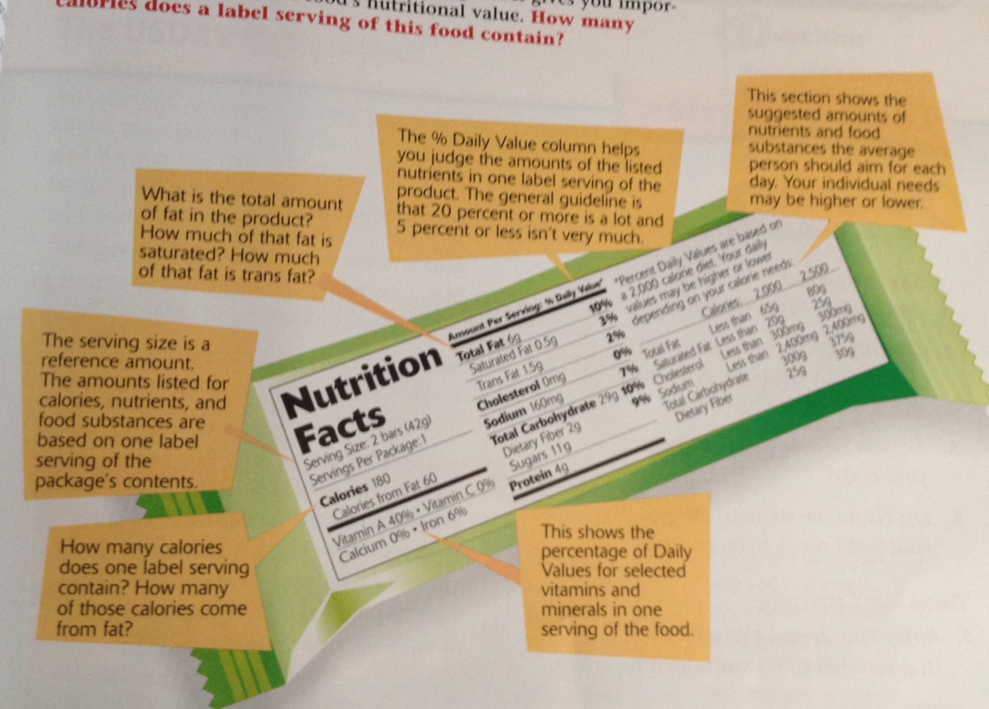

Slide 13
Homework!!
Please bring in a food label for next class
  Can be from anything

