Slide 1
CHAPTER 12 LESSON 6
THE LIFE CYCLE
pg. 388

Slide 2
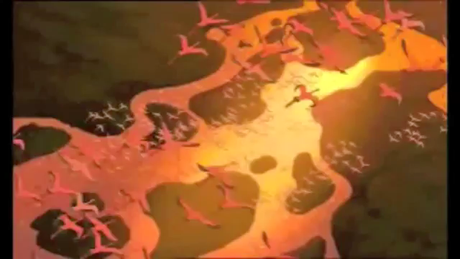
Stages of Life

Slide 3
Infancy
First year of life after birth
Exploring and responding to the world around them
Start to recognize and speak some words
By the end of year 1 → standing/walking

Slide 4
Childhood
Toddler → ages 1-3
  Feeding themselves, potty train, developing language skills
Preschooler → ages 3-5
  Develop more complex physical and mental skills
  Learn how to follow rules and make friends
Late childhood → ages 6-11
  Physical growth continues
  Become more independent
  Develop social skills

Slide 5
Adolescence
Ages 12-18
Puberty → getting the body ready for reproduction
Take on more responsibilities
Choices will help shape the paths into adulthood

Slide 6
Adulthood
Young adulthood → age 19
  Physical growth slows, but development occurs on the other sides of the triangle
  Begin careers and develop deeper relationships with others
Middle age → 30s-50s
  Strengthening of careers, relationships, and families
After middle age → signs of physical aging
  Travel, retire
Death → end of the life cycle

Slide 7
Preparing for Adulthood
Reducing risks by:
  Preventing injury
  Choosing a healthy lifestyle
  Abstaining from drugs and alcohol
Moving toward the future

