Slide 1
CHAPTER 4 LESSON 3
PLANNING HEALTHFUL MEALS
PAGE 116

Slide 2
HEALTHFUL EATING HABITS
Can promote health and prevent disease
Use MyPyramid as a guide to eat a variety of foods from all groups
Pay attention to portion size
  Portion of meat = deck of cards
  Portion of peanut butter = golf ball
  One cup = baseball
Can take supplements if there is a dietary restriction
  Talk to your doctor before doing this!!

Slide 3
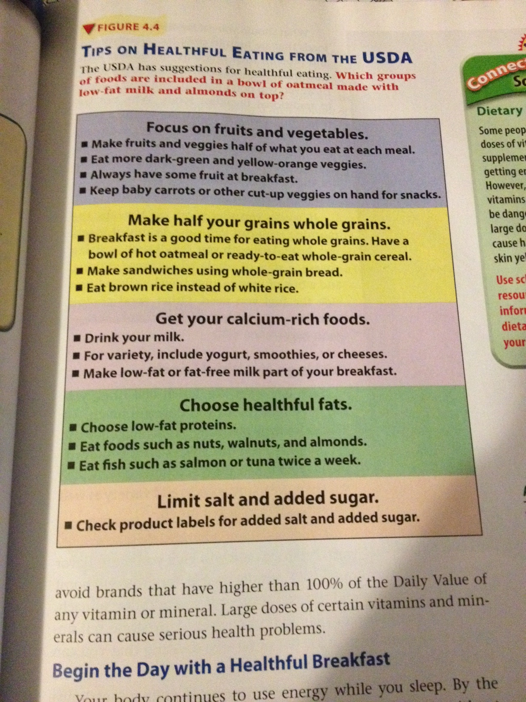

Slide 4


GOOD MORNING!
Eating breakfast is GRRRRRR-EAT!
You’ve gone 10-12 hours without eating and you wake up like this

Slide 5


GOOD MORNING!
Eating breakfast every morning will make you want to do this all day long

Slide 6
BUT SERIOUSLY…
Eating breakfast every morning will give you energy to start your day
  You’ll be able to focus better
It’s also easier to maintain a healthy weight
  Metabolism is started earlier
  Controls overeating later in the day

Slide 7
BUT WHAT DO I EAT FOR BFAST?
Complex CHO and protein
  Oatmeal, whole grain toast
  Eggs, milk, fruit (what kind of CHO is this?)
In a hurry?
  Peanut butter on whole grain toast
  Trail mix
  Smoothie

Slide 8
IT’S 11:02 AND I’M STARVING
Check to see what is for lunch in the cafeteria
  Nutrition facts on BPS website
If possible, pack your own
Want a sandwich?
  Use whole grain bread, low sodium deli meats and cheeses
Salad
  Get creative! But watch what you put in it (add-ins and dressing)
Yogurt, applesauce, fruit, granola bar
Refrain from soft drinks and juices with added sweeteners

Slide 9
SNACK TIME
Always choose foods that are nutrient dense
  Having a high amount of nutrients relative to the number of calories
  Potato chips vs. yogurt with low fat granola
Trail mix, vegetables with low fat ranch dressing or hummus
Read the food labels for information!

Slide 10
KEEPING FOOD SAFE
Keep your hands, utensils, and surfaces clean
Separate raw, cooked, and ready-to-eat foods
Cook foods thoroughly
Chill when necessary
Serve safely
Follow directions
When in doubt, throw it out!

