Slide 1
Chapter 6 Lesson 3
Your Friendships And Peer Pressure

Slide 2
Friends Are Important
Friendship
  Relationship with someone you know, trust, and regard with affection
Acquaintance
  Someone you see occasionally or know casually
These relationships take time
What are some benefits of friendship?

Slide 3
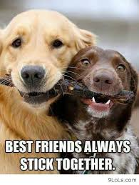
Traits Of A Good Friend
Trustworthy
Caring
Respect
Loyalty
Any others?

Slide 4
Building Friendships
Meet friends who have similar interests as you
Communication → open and honest
Supportive
Encourage them
Be Tolerant

Slide 5
Compromise
Both sides in a conflict agree to give up something in order to reach a solution that satisfies everyone
NEVER compromise when the decision may put you or others in danger
  Be firm and say no

Slide 6
Peer Pressure
The influence that your peer group has on you
Negative
  Can involve pressure to use drugs, drink, copy homework, or break any rule

Slide 7


Slide 8
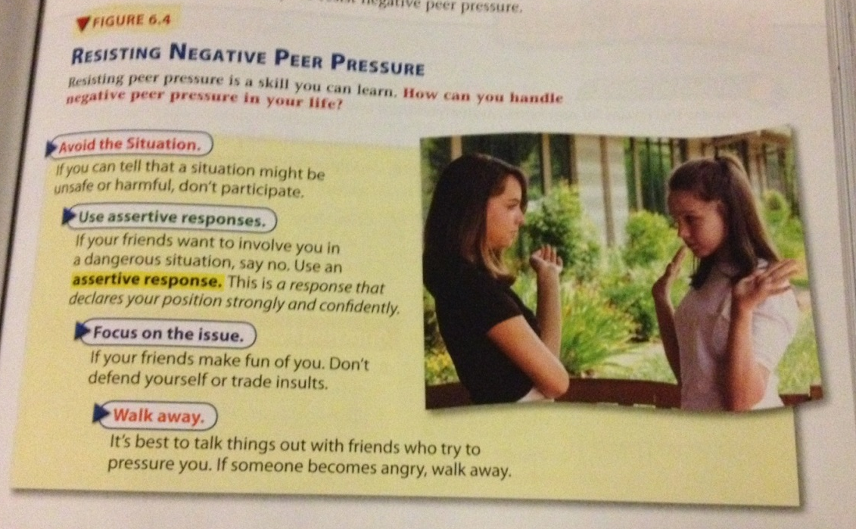

Slide 9

Peer Pressure (cont’d.)
Positive
  Suggesting to do the right thing
  Help you to say no to risk behaviors
  Make you feel better about yourself

