Slide 1
CHAPTER 12 LESSON 5
HEREDITY AND HUMAN DEVELOPMENT
pg. 383

Slide 2
heredity
Genetic material is passed from parent to child
Chromosomes → threadlike structures that carry genes in the cell’s nucleus
Genes → basic units of heredity
  Carry the codes for traits

Slide 3
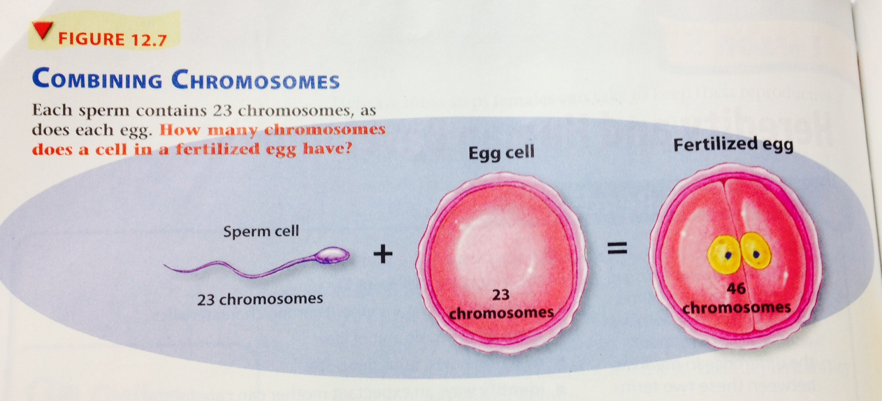
Combining chromosomes

Slide 4
Fertilization and human development
Cell → basic unit of life
  We are made of millions of them!
However, a fertilized egg is a single cell
  Soon after fertilization, the egg begins to divide and multiply
Cells start to form more complex body parts:
  Tissue: group of similar cells that do a particular job.
    Lining of the stomach
  Organs: body part made up of different tissues joined to perform a particular function.
    The stomach
  Body System: group of organs that work together to carry out related tasks
    The stomach is a part of the digestive system

Slide 5
Development of the fetus
Fertilized egg is called a zygote
Zygote → starts dividing about 24 hours after fertilization
After 1 week → zygote attaches itself to the lining of the uterus
2 weeks – 8 weeks→ zygote is now an embryo
9 weeks – Until birth → embryo is now a fetus
Fetus gets nutrients and oxygen through the umbilical cord

Slide 6
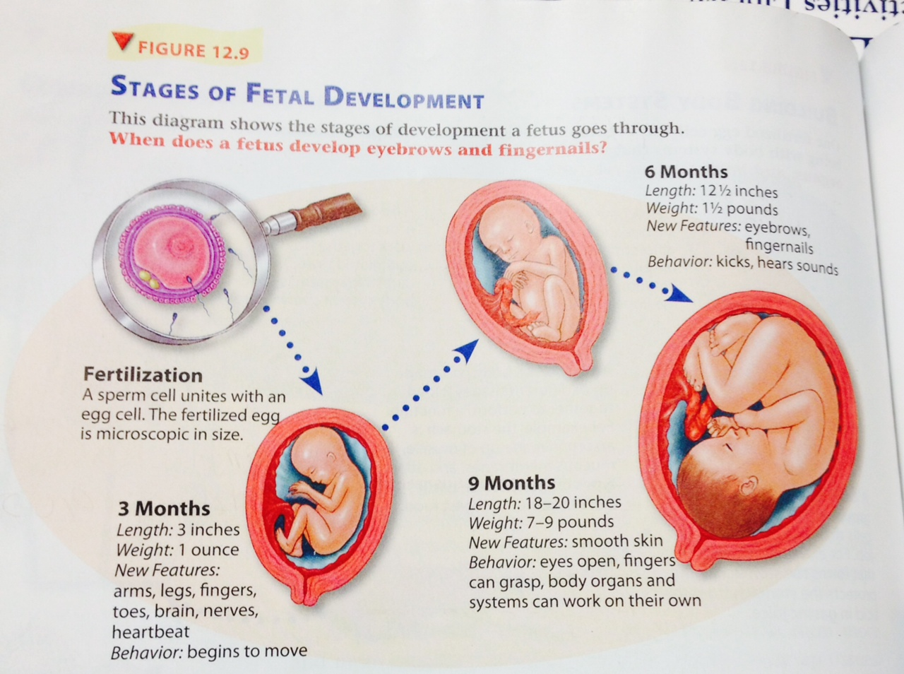

Slide 7
Care during pregnancy
Eat healthful foods
  Fetus gets nourishment directly from the mother
Have regular checkups
Beware of infections
Don’t use tobacco or drink alcohol
Don’t take any unnecessary drugs
  Speak to a doctor before taking medication

