Slide 1
CHAPTER 8 LESSON 1
HOW TOBACCO AFFECTS THE BODY
PAGE 230

Slide 2
TOBACCO IS WHACKO
A single puff of tobacco smoke contains more than 7,000 harmful chemicals
  Several of these can cause cancer
In the U.S., more than 400,000 people become smokers daily
4% of middle schoolers were cigarette smokers in 2011 (CDC)

Slide 3
WHAT’S IN TOBACCO?
Nicotine → addictive, habit forming drug
Tar → thick, dark liquid that forms when tobacco burns
Carbon Monoxide → colorless, odorless, poisonous, gas produced when tobacco burns

Slide 4
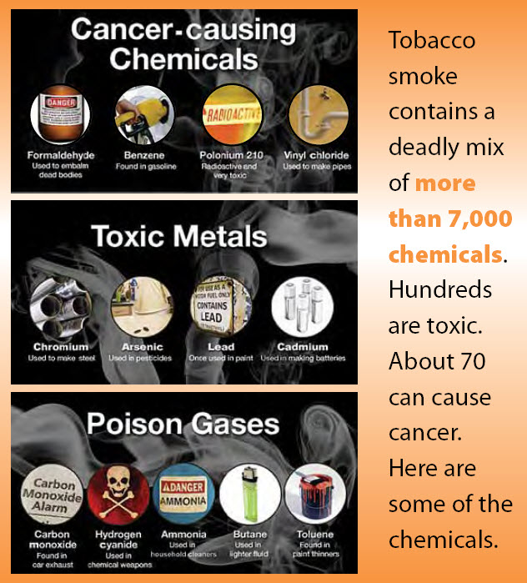

Slide 5
FORMS OF TOBACCO
Cigarettes
  Contain shredded tobacco leaves
  Some have filters, but they are still dangerous
    No such thing as a safe cigarette!
  Hookah and vapor pens are not safer alternatives!
Cigars/Pipes
  Also have shredded tobacco leaves
  Have up to 90x more of the chemicals found in cigarette smoke

Slide 6
FORMS OF TOBACCO (CONT’D.)
Smokeless tobacco
  Chewing tobacco (“dip”, “spit”)
  Snuff
  Not passed to the lungs, but held in the mouth
  Absorbed into the tissues/bloodstream through the digestive tract
  Just as harmful and addictive as cigarettes

Slide 7
