Slide 1
CHAPTER 2 LESSON 3
BUILDING GOOD CHARACTER
PAGE 47

Slide 2
WHAT IS CHARACTER?
The way a person thinks, feels, and acts
Improves your relationships with friends and family
Also improves all aspects of your health triangle
  Examples?

Slide 3
TRAITS OF A GOOD CHARACTER
Trustworthiness
  Involves integrity → being true to your ethical values
Respectful
Responsible
Fair
Caring
Citizenship
Compassion

Slide 4
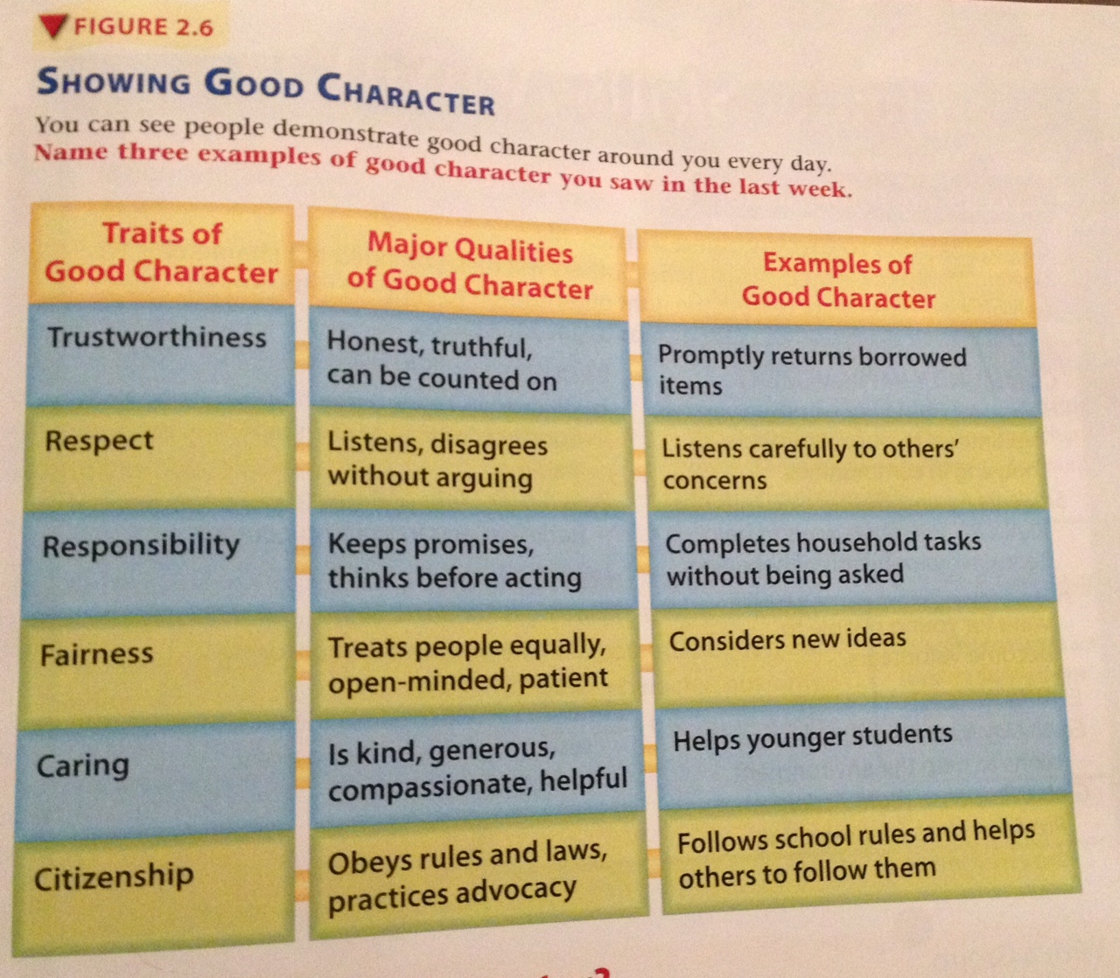

Slide 5
WHAT SHAPES YOUR CHARACTER?
Life experiences
  Parents, guardians, teachers, coaches
  How you’re treated
  Getting involved in various activities
Role models
  Inspire you to think or act a certain way
  Siblings, teachers, coaches, doctors, police officers, community workers, etc.

Slide 6
HOW TO DEVELOP GOOD CHARACTER
EFFORT!!

