Slide 1
CHAPTER 4 LESSON 5.6
BODY IMAGE AND HEALTHY WEIGHT
PAGE 128

Slide 2
BODY IMAGE
The way you see your body
Can be influenced by:
  Attitudes of family/friends
  The media
Am I too thin? Do I need to lose weight? Why does my body look this way?
People who are unhappy with their body may have a poor body image
  May go to extreme measures to change this

Slide 3
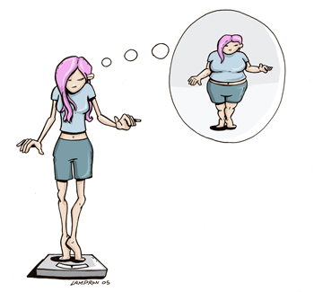
EATING DISORDERS
Extreme eating behaviors that can lead to serious illness or even death
90% of teens with eating disorders are female

Slide 4
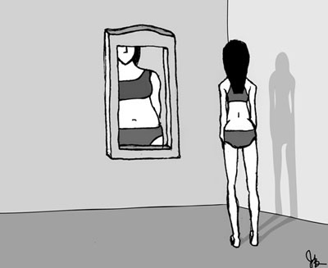
ANOREXIA NERVOSA
When a person strongly fears gaining weight and starves him/herself
Even if they are slim, they believe they are overweight
Deprived of nutrients
  What happens to our bones and muscles?

Slide 5
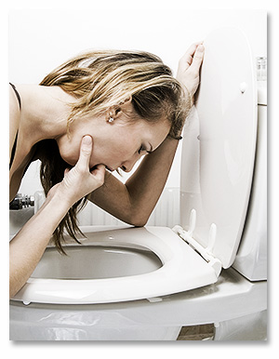
BULIMIA NERVOSA
When a person repeatedly eats large amounts of food and then purges
Throw up, use laxatives, excessive exercise
Robs the body of nutrients, but also harms the body
  Colon, liver, heart, and kidney damage, enamel erosion, damage to stomach and esophagus lining, dehydration

Slide 6
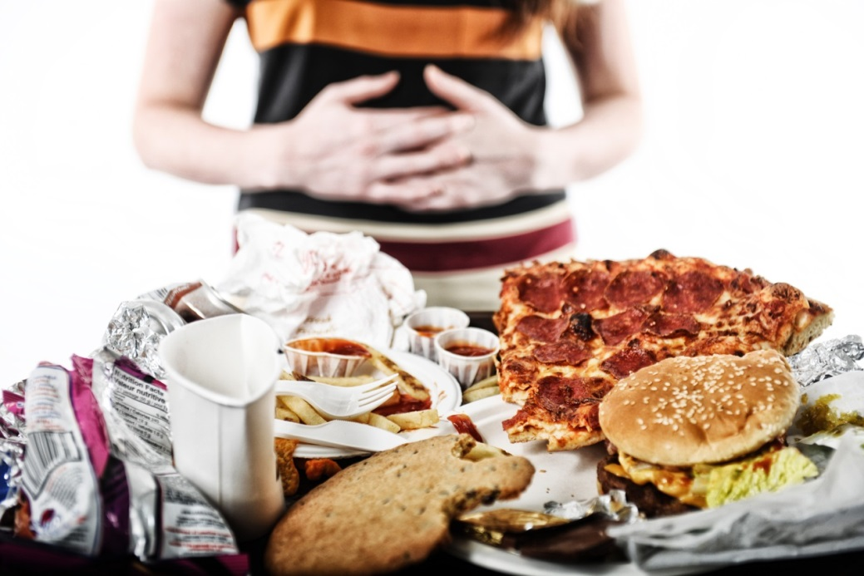
BINGE EATING
When a person repeatedly eats too much food at one time
Fast/diet to lose the weight
Can lead to serious weight gain, heart disease, and diabetes

Slide 7
HOW TO DEVELOP A POSITIVE BODY IMAGE
Accept yourself and your body
  Our gender and genes affect our body shape
Don’t compare yourself to the people on TV
  There is no correct body shape or size
Growth stage affects weight as well
If you need to lose/gain weight to be healthier…
  SET GOALS → and at a reasonable pace

Slide 8
FINDING YOUR HEALTHY WEIGHT RANGE
How do we find this?
  BMI
Try to maintain this
  Balance the calories you eat with the calories your body uses
    BMR
  Choose healthful foods and stay active
  Take your time when you eat
  Avoid fad diets

Slide 9
YOU ARE BEAUTIFUL
http://www.operationbeautiful.com/

