Slide 1
CHAPTER 12 LESSON 1
CHANGES DURING ADOLESCENCE
pg. 364

Slide 2


Slide 3
WHAT HAPPENS DURING ADOLESCENCE?
Adolescence – the stage of life between childhood and adulthood (ages 11-15)
Physical growth
Mental/Emotional growth
Social growth

Slide 4
Physical growth
Puberty – the time when you develop physical characteristics of adults of your own gender
This is normal!
Different growth rates
  Anywhere from age 8-13

Slide 5
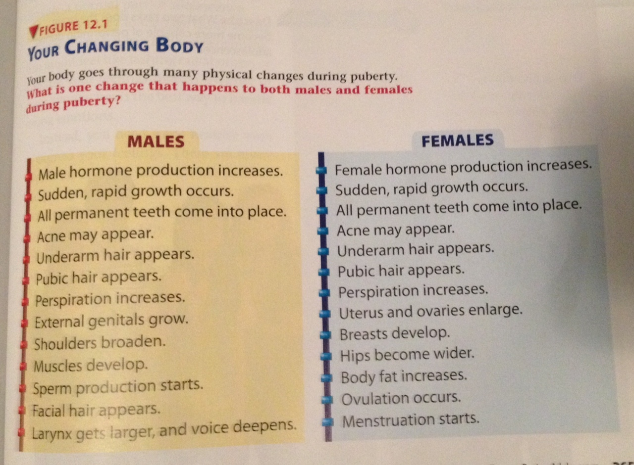

Slide 6
Mental growth
Brain is developing → increase in problem solving skills and complex reasoning
Develop own opinions, values, and beliefs
Emotionally
  Start to feel differently about your peers, parents, and other adults
  Mood swings → manage emotions in a positive way
    Don’t lash out or keep feelings hidden
    How can we manage our emotions healthfully?

Slide 7
Social growth
This is the time to find out more about yourself and those around you
You interests will change, don’t be afraid to explore!
Social connections (positive) can help:
  Develop friendships
  Find job opportunities
  Get emotional support

